Slide 1

Smart Contract
&
Real -Estate

Slide 2

About Us
TEAM NAME - CREATION FOR INNOVATION
TEAM LEADER - PIYUSH MANTRI
In recent years, Blockchain has received considerable attention from many researchers and government institutions. This problem aims to present the Blockchain and smart contract for a specific domain which is real estate. A detailed design of smart contract is presented.
KEYWORDS - Blockchain, Ethereum, Smart Contract, Smart City, Real Estate

Slide 3
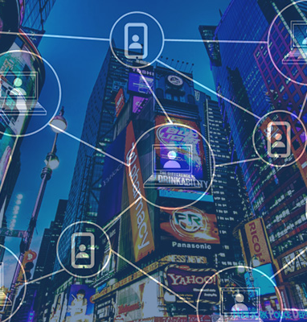
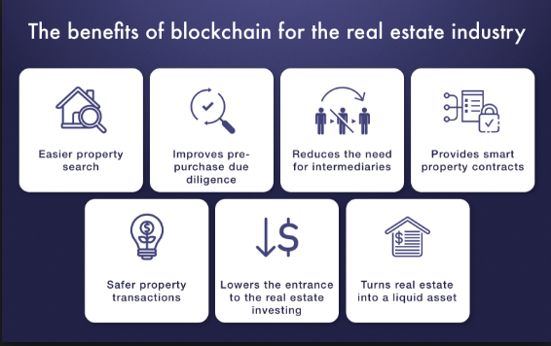
Our Current Issue
Lack of Trust
Tampering of the Papers
Difficulty in Property Search & Transactions
Centralized Recordkeeping & Intermediates

Slide 4


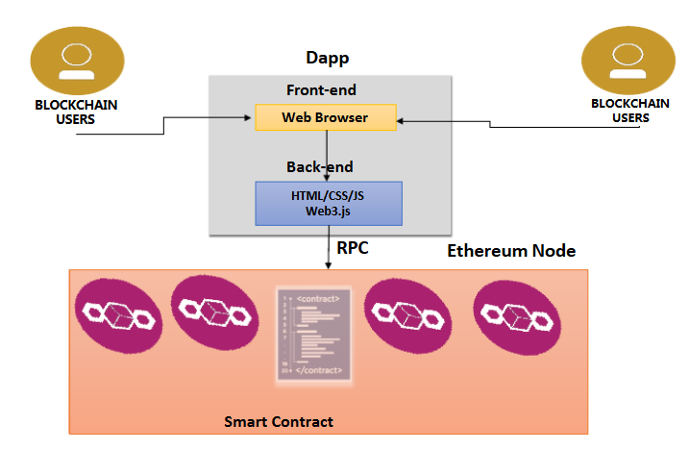

Our Product
We propose a design methodology for the smart contract which enables development of different use cases using Blockchain technology. A detailed state finite functions and processes are described for a specific use case providing noteworthy contributions to real estate domain. In this frame, the blockchain becomes the enabler for the development of paperless layer for all city transactions, in a secure fashion for the optimum management of the smart city’s assets

Slide 5
DATA FLOW DIAGRAM
CONTRACT
INPUT
OWNER ADDRESS
ADD LAND
OWNER ADD.
LOCATION
LOCATION
COST
COST
LAND ID
OWNER ADDRESS
BLOCKCHAIN
NETWORK
UPDATE
OUTPUT
LAND ID
LOCATION
COST

Slide 6
CONTRACT
TRANSFER
BUYER ADDRESS
OWNER ADDRESS
REQUIRED
VERIFICTION OF REQUEST , IS IT GENERATED BY OWNER ADDRESS OR NOT , IF NOT IT WIIL FAIL
METAMASK
PAYMENT
PROCESS
CONFIRM?
NO
YES
REJECTED
TRANSFERED

Slide 7
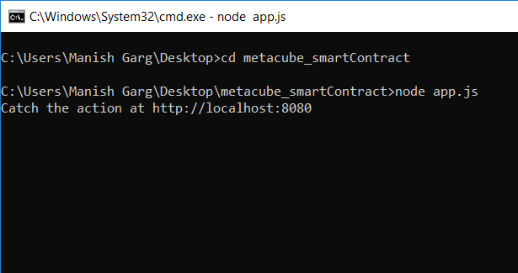
WORKING

Slide 8
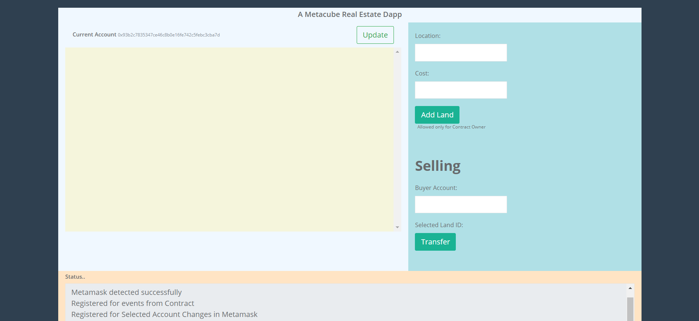

Slide 9
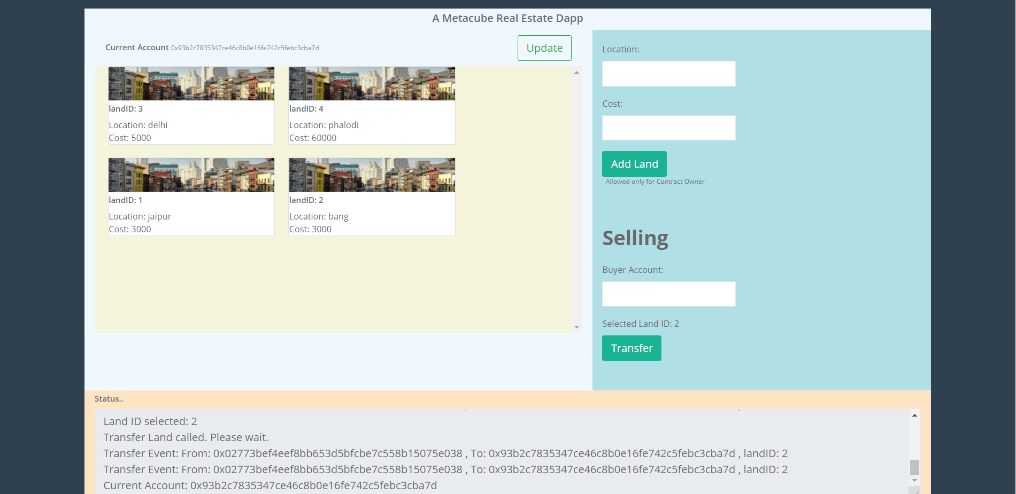

Slide 10
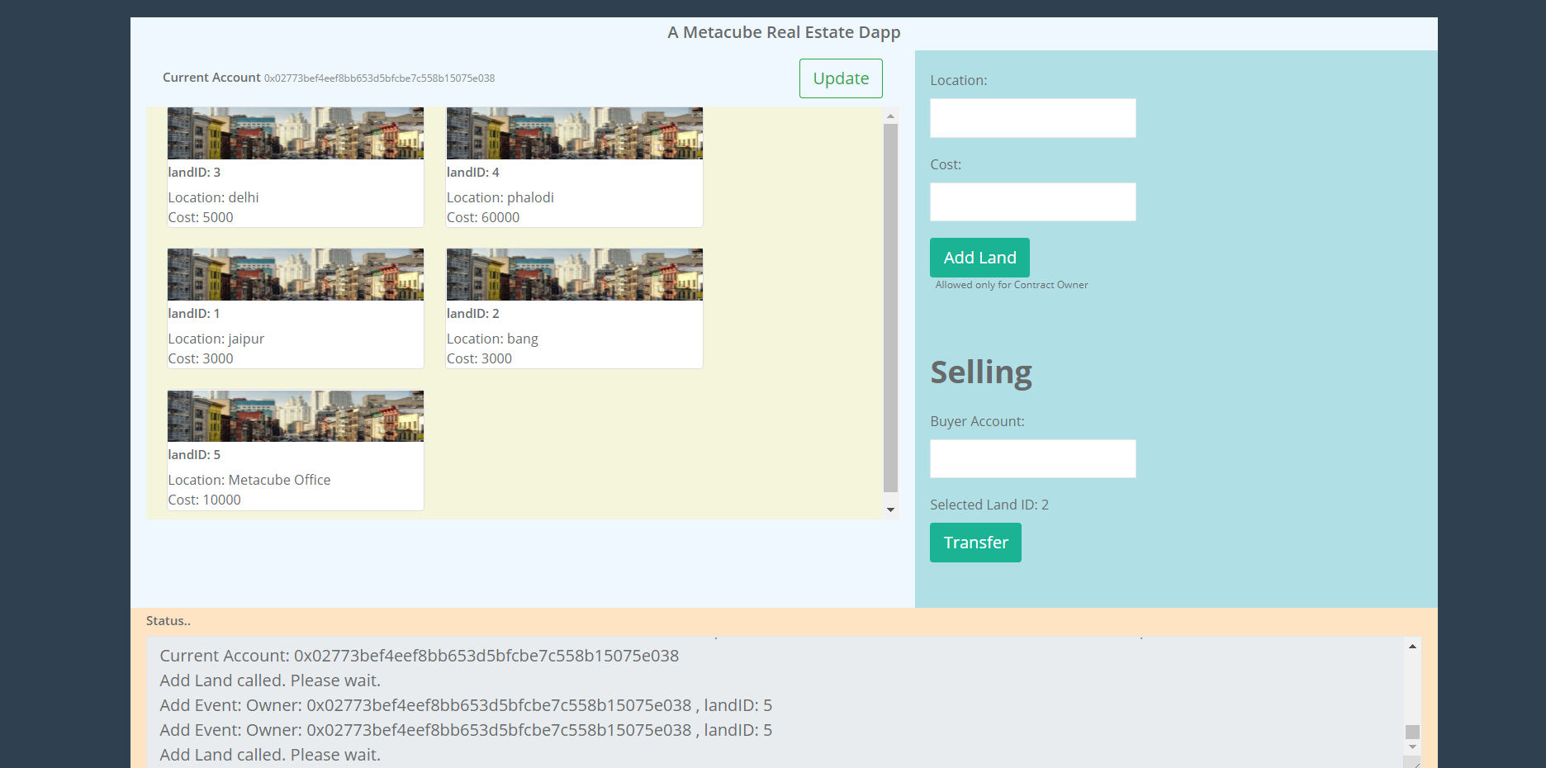

Slide 11
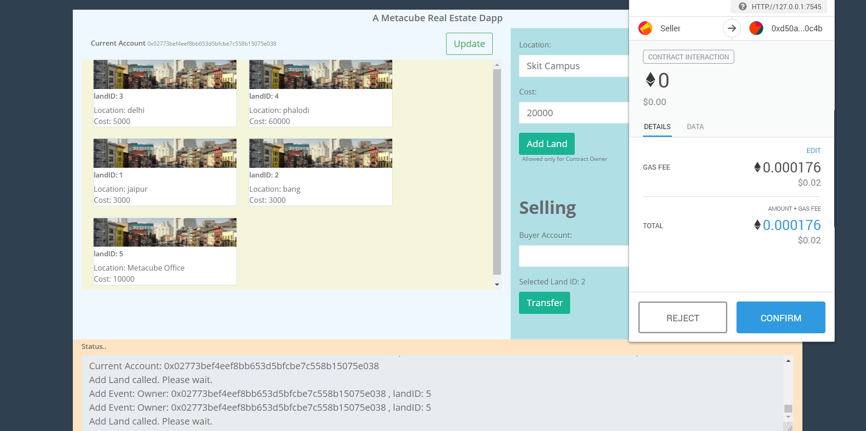

Slide 12
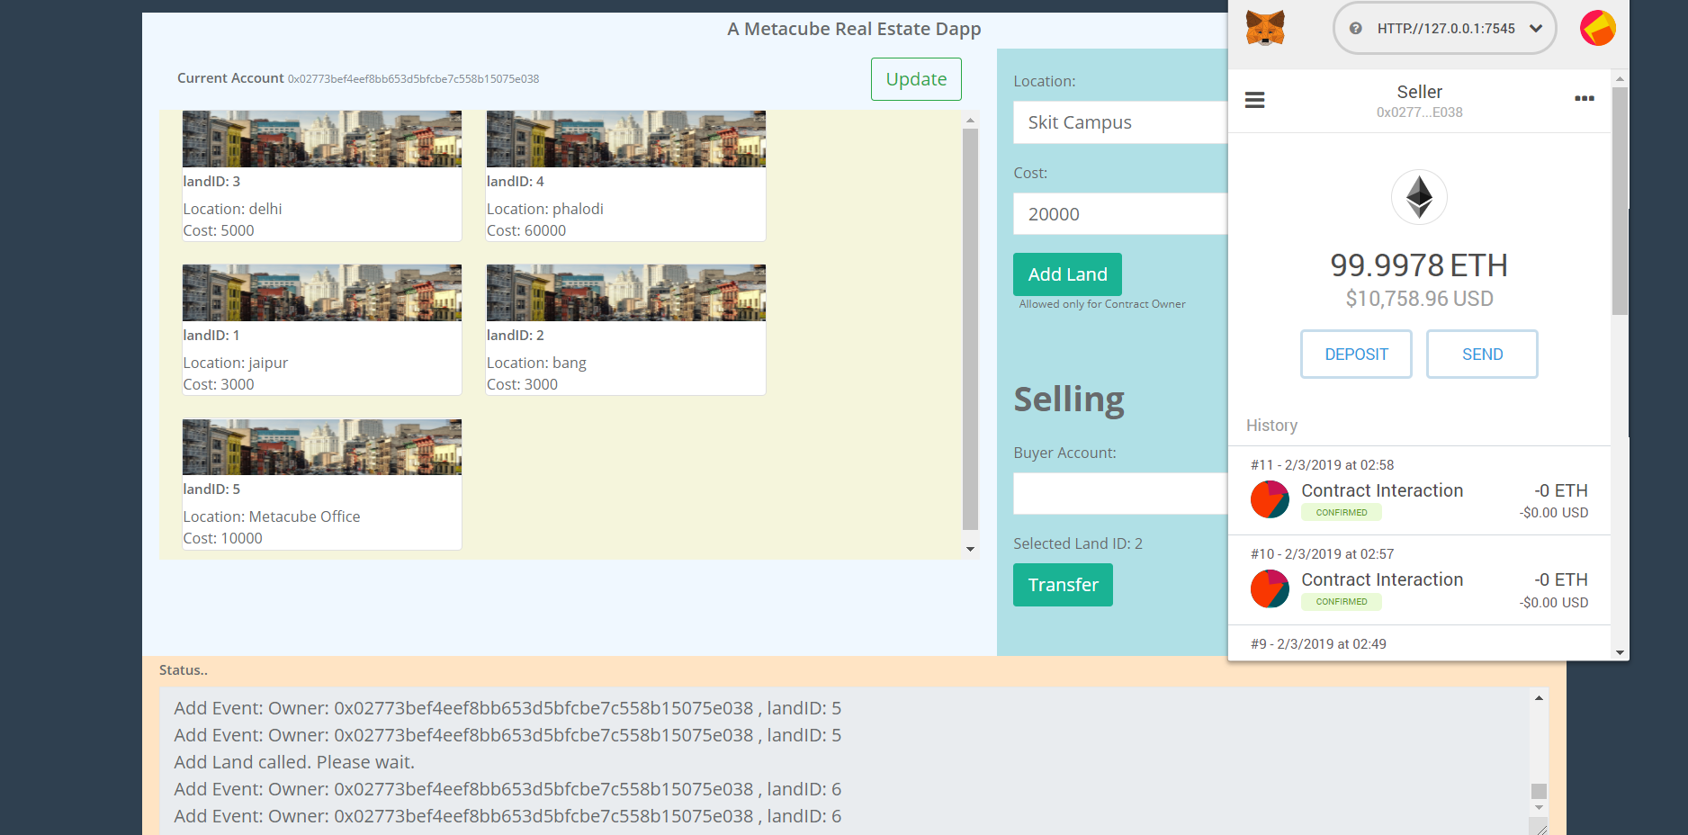

Slide 13
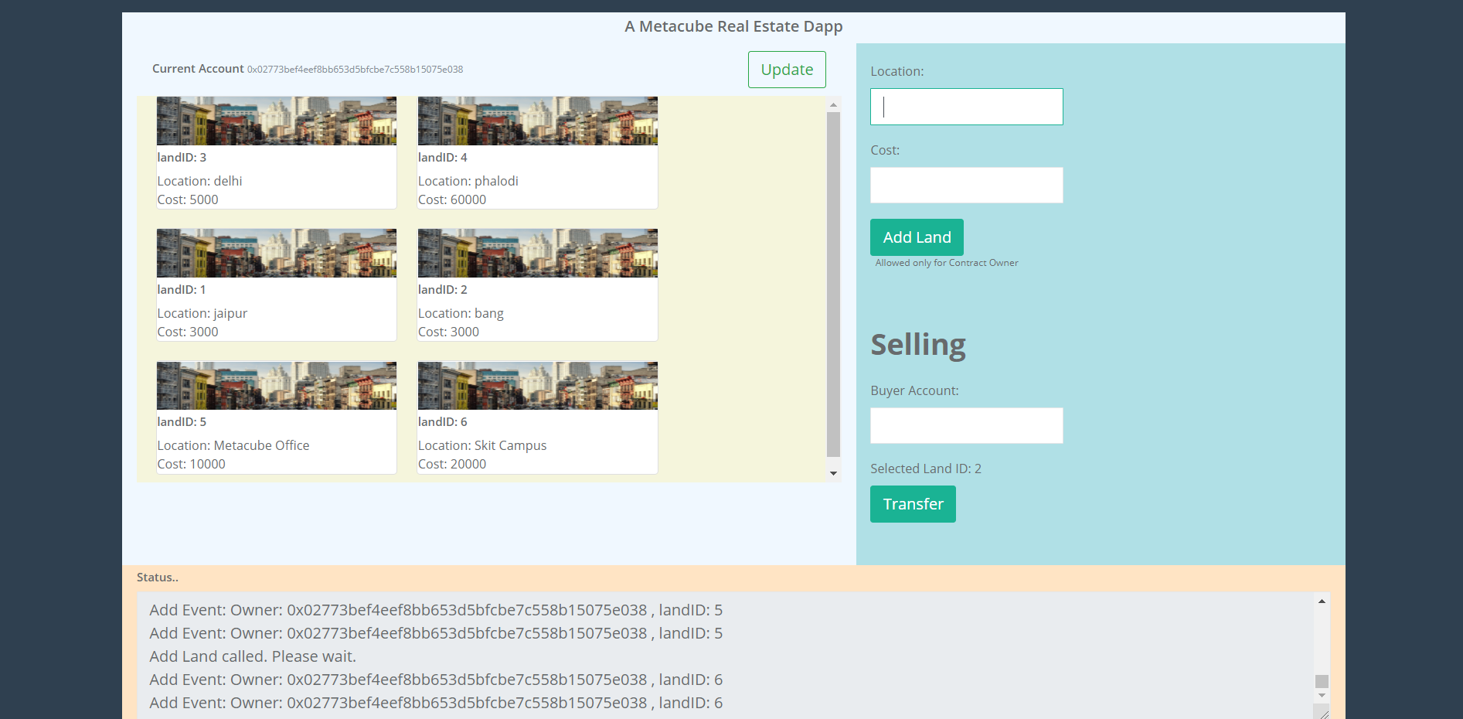

Slide 14
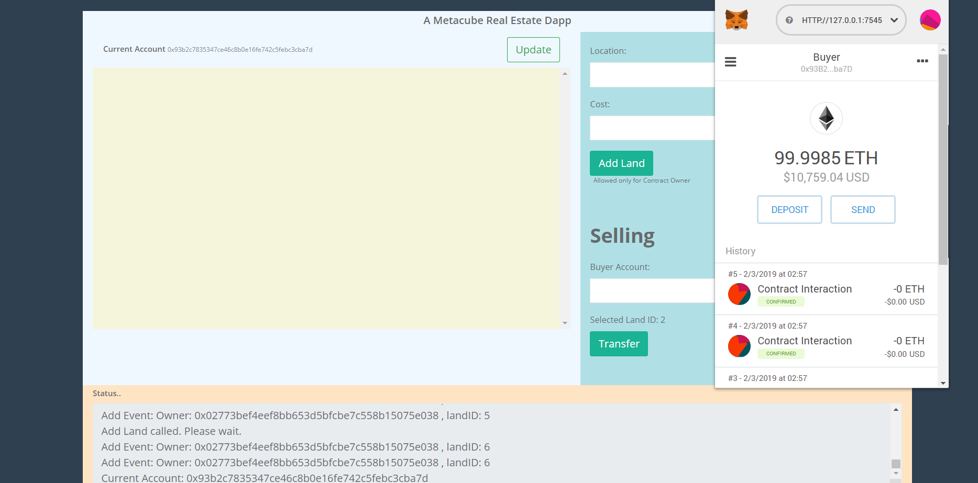

Slide 15
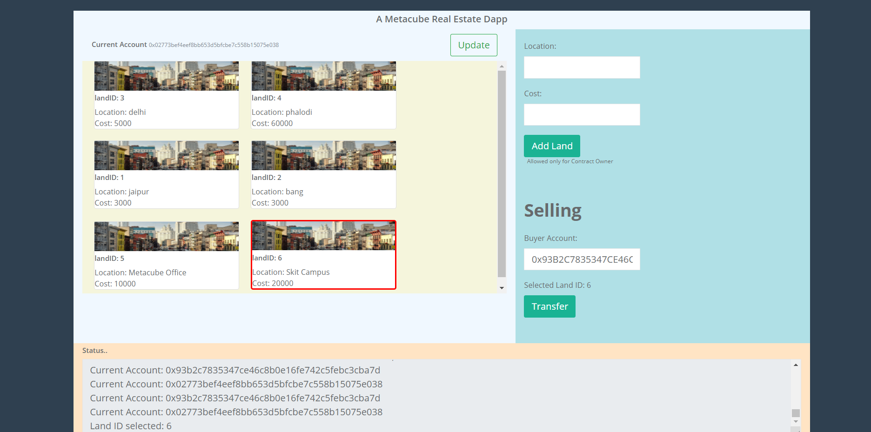

Slide 16
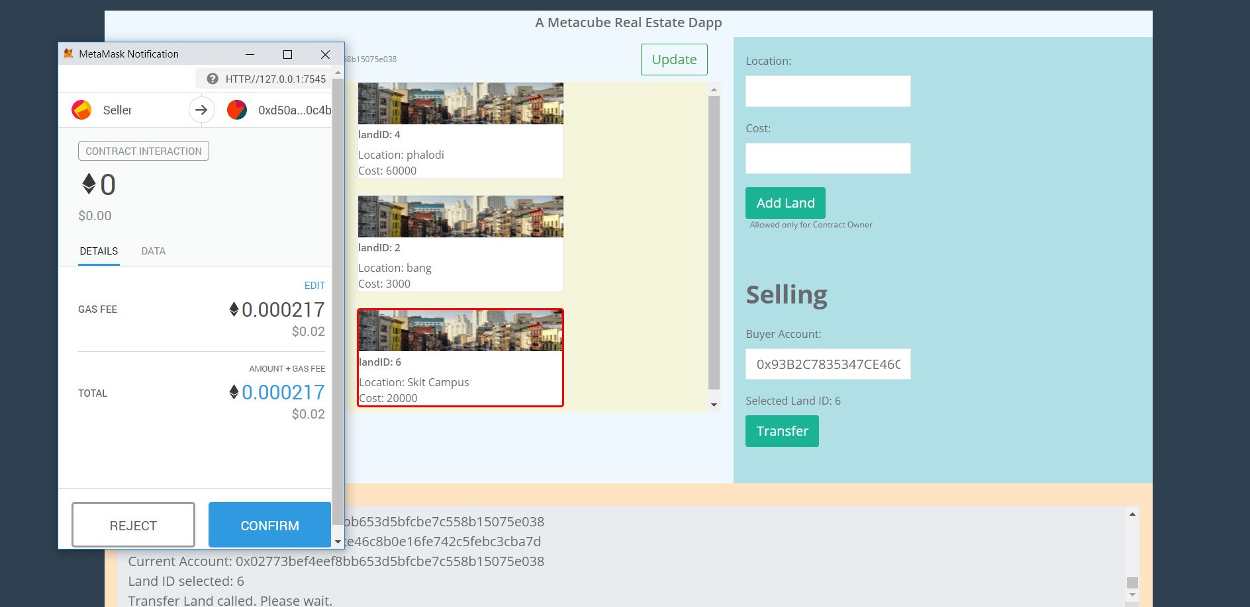

Slide 17
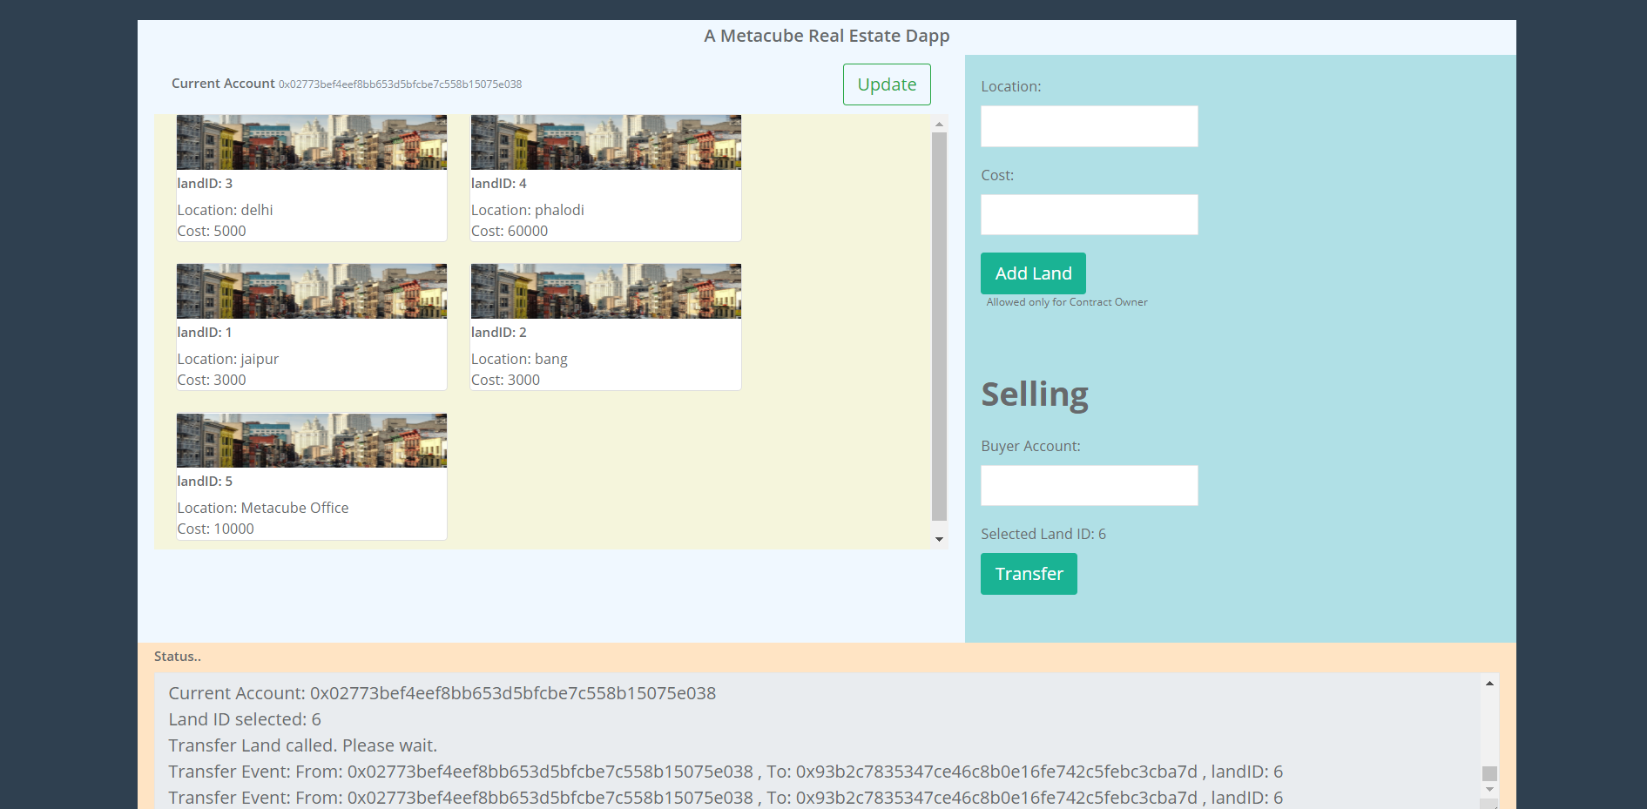

Slide 18
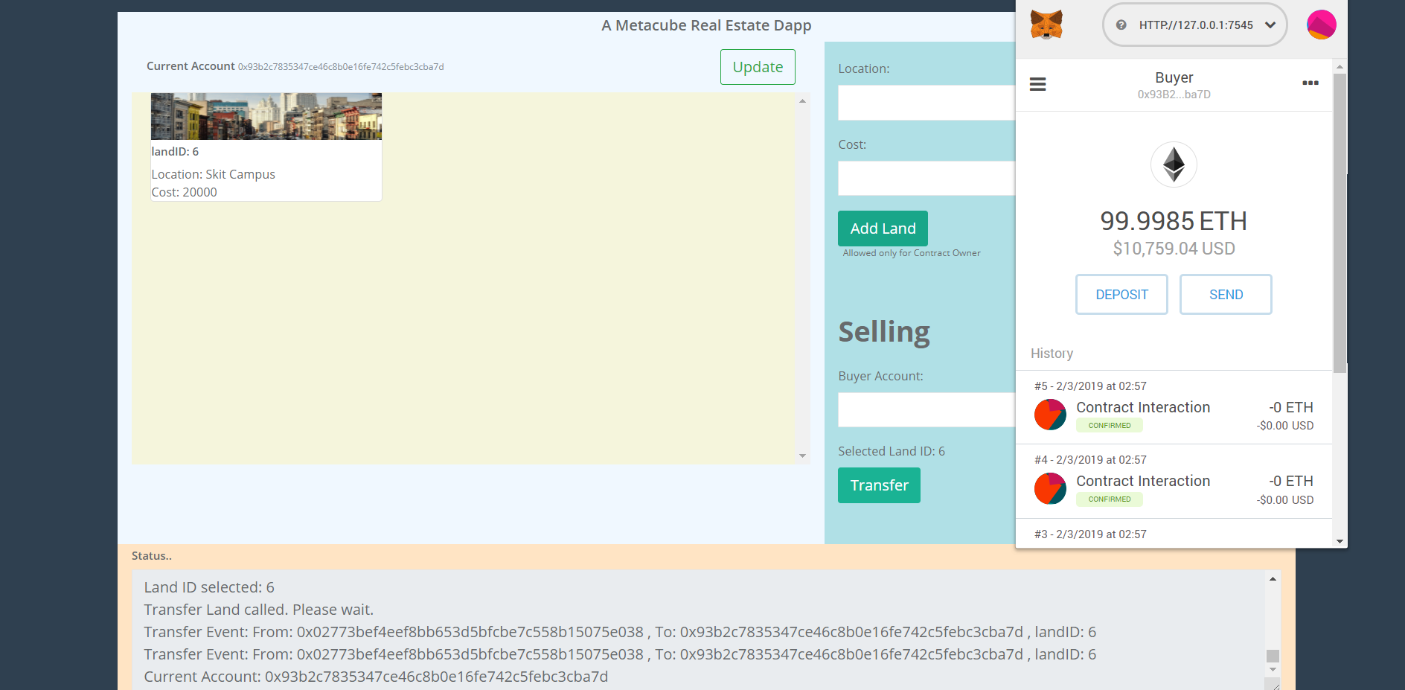

Slide 19




Thank You
Creation For Innovation
+91 9116519139
piyush92mantri@gmail.com

